Slide 1
Women in the Bible: Deborah and me
“Your word is lamp for my feet and a light for my path.”
Psalm 119:105
Courage and Empowerment
1
LESSON

Slide 2
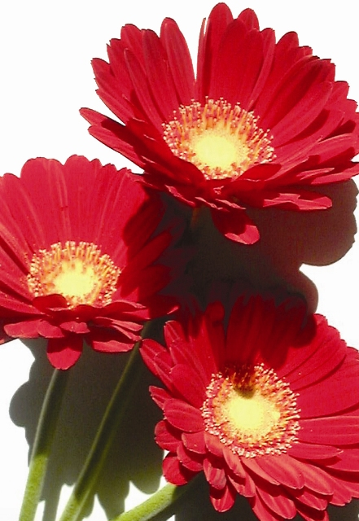
Deborah
Her Name Means “Bee”
Key Scripture: Judges 4 and 5
Introduction
Deborah was the fifth judge of Israel. At a dark time in Israel’s history, Deborah illustrated God’s power to deliver. One of the outstanding characteristics she demonstrated was her willingness to step outside of the traditional role of women in order to bring a blessing to her country.

Slide 3
Deborah
Her Name Means “Bee”
It is the calling and the gifts of God that bring a person into the ministry of the Lord. Your gender does not determine your calling or your mission. As you dedicate yourself to the Lord and seek His face, you will be prepared to fulfill His will for your life.

Slide 4
Deborah
Her Name Means “Bee”
The resources Deborah had are available to you today. Deborah provides you an example of a woman who was willing to be used by God.

Slide 5
Deborah
Her Name Means “Bee”
Discover
* Her Role in Society
* Her Leadership Abilities
* Her Ability to Follow Through on a Commitment

Slide 6
Deborah
Her Name Means “Bee”
Going Deeper
Describe the political situation in Israel at the time of Deborah’s judgeship. (Verses 1-3)
2. What were the directions Deborah gave to Barak? (Verses 5-7)
3. Barak responded with what unusual request? (Verses 4-8)
Note: It was most unusual for a woman to go with the men into battle. Yet Deborah agreed to go without any apparent hesitation. Deborah then told Barak that the honor of capturing Sisera would not be his, but instead would go to a woman. (Verse 9)

Slide 7
Deborah
Her Name Means “Bee”
4. Read the account of the battle in verses 10-16.
5. Sisera fled away to the tent of what woman? (Verse 17)
6. Jael extended the traditional hospitality to Sisera and invited him to come into her tent. Read verses 17-20.
7. What brave act did Jael perform that ended Sisera’s life? (Verses 21-22)
8. What was the response of the people when Deborah and Barak came back victorious from the battle? (Judges 5:1-3)

Slide 8
Deborah
Her Name Means “Bee”
Words for Today
9. How do I react when given a challenge?
10. How can I become more willing to go forward with courage, trusting God to empower me with the talents and abilities I will need for the work I am to do?
11. Think of a time when you were asked to do a task you did not feel capable of handling. Where did you turn for help? If you found the confidence you needed to fulfill the job, how did you do so? Have you more than one source of encouragement available? Explain.

Slide 9
Deborah
Her Name Means “Bee”
Questions for Discussion
If a woman had the right to prophesy, may she not also have the right to preach?
2. Does this story suggest a need for women to become involved in politics? If so, when might this be especially important? Explain.

Slide 10
Deborah
Her Name Means “Bee”
Words of Wisdom
We are all faced with times when we do not know what to do, or we doubt our ability to accomplish what needs to be done. In Philippians 4:13 (NIV) we are told, “I can do everything through him who gives me strength.” When we lean upon the Lord, He will help us do the work He puts before us. With the guidance and help of the Lord we will be able to accomplish much more than we may have thought possible. Faith will carry us through difficulties and enable us to be His workers.

Slide 11
Deborah
Her Name Means “Bee”
My Prayer for Today
Lord, give me the abilities I need to carry out Your plan for me. Make me willing and
ready to go on Your errands, even when the task may be something entirely out of my comfort zone.

Slide 12
Deborah
Her Name Means “Bee”
Sharing
Deborah clearly possessed leadership ability. As a judge, she played a dominant role in her time. What does this suggest about women’s potential for major leadership positions today? As we study the strength of Deborah and Jael, let us as women encourage each other to train for and accept positions of leadership to which God has called us. Who is a woman you can encourage to become a leader?

